Slide 1
Chap-13
Join Types
 Simple join
Inner & Outer Joins
 Self-Joins,
equi join
non equi join

Slide 2
Aliases
“Shorthand”for Table or Column
References
SELECT Aliases Appear as Column
Headers in the Output
Aliases Cannot be Keywords (SELECT,
FROM, WHERE, etc)

Slide 3
Joining Tables Together
Joins Between Tables are Usually Based
on Primary / Foreign Keys
Make Sure Joins Between All Tables in the
FROM Clause Exist
List Joins Between Tables Before Other
Selection Elements

Slide 4
Join
Let us see which student is registered for which class:
SELECT S.ssn, SC.class
FROM students S,students_classesSC
WHERE S.ssn= SC.student
ORDER BY class

Slide 5
Join
This is exactly the same as:
SELECT S.ssn, SC.class
FROM students S JOINstudents_classesSC
ON S.ssn= SC.student
ORDER BY class

Slide 6
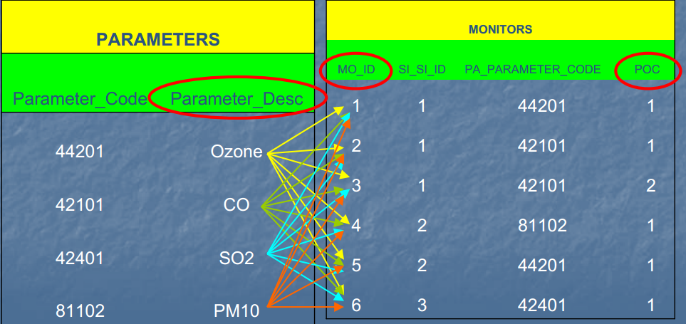
Cartesian / Simple Join
SELECT mo_id, poc, parameter_desc FROM monitors, parameters

Slide 7
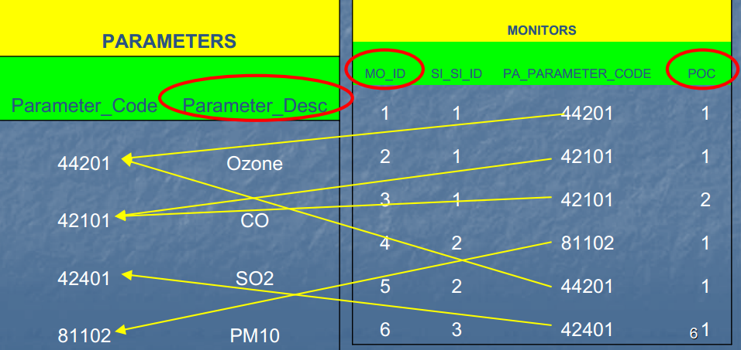
Inner Join Between 2 Tables
SELECT mo_id, poc, parameter_desc FROM monitors, parameters WHERE pa_parameter_code = parameter_code

Slide 8
Left outer join
But for some reason we would also like to include the students who are not registered for any course. This is where an outer join comes handy:
SELECT S.ssn, SC.class
FROM students S LEFT OUTER JOIN students_classesSC
ON S.ssn= SC.student
ORDER BY class

Slide 9
Left outer join
Or, in Oracle's traditional syntax:
SELECT S.ssn, SC.class
FROM students S, students_classesSC
WHERE S.ssn= SC.student(+)
ORDER BY class;
You are bound to meet old school Oracle programmers who
swear by the (+) syntax. So, to be on the safe side, learn both
syntaxes and avoid getting into a fight with a senior colleague
overa (+).

Slide 10
Outer Joins
Place a “(+)”Next to the Column Name in
the WHERE clause of the SHORTER table
Where to Use:
When you have null values in a column that
you are joining on
When a parent record may not have a child
record
A Table Can Only Be Outer Joined to One
Other Table within a Given Query

Slide 11
Right outer join
What if in addition we would like to see all classes, disregarding if someone has registered for them or not?
SELECT S.ssn, SC.class
FROM students S RIGHT OUTER JOIN
students_classesSC
ON S.ssn= SC.student
ORDER BY class

Slide 12
Right outer join
Or, in Oracle's syntax:
SELECT S.ssn, SC.class
FROM students S, students_classesSC
WHERE S.ssn(+)= SC.student
ORDER BY class;
This however does not yield anything new. Why?

Slide 13
Outer join
But if we do this:
SELECT SC.student, C.class
FROM students_classesSC RIGHT OUTER JOINclasses C
ON C.class_code= SC.class
ORDER BY class_code;
Or, in Oracle's syntax:
SELECT SC.student, C.class_code
FROM students_classesSC, classes C
WHERE SC.class(+)= C.class_code
ORDER BY class_code

Slide 14
Outer join
And let us see all students and classes they are taking, plus
students who are not taking any classes and classes for which
nobody registered.
SELECT S.ssn, SC.class
FROM students S, students_classesSC
WHERE S.ssn= SC.student(+)
UNION
SELECT SC.student, C.class_code
FROM students_classesSC, classes C
WHERE SC.class(+) = C.class_code

Slide 15
Outer join
A word of caution, though. Let’s say you would like to get all
students who are taking CIS525 plus all other students, even
though they are not taking CIS525:
SELECT S.ssn, SC.class
FROM students S, students_classesSC
WHERE S.ssn= SC.student(+)
ANDSC.class= 'CIS525'
ORDER BY SC.class

Slide 16
Outer join
We did not get the outer join because AND overrides the outer
join condition. This is the correct syntax:
SELECT S.ssn, SC.class
FROM students S, students_classesSC
WHERE S.ssn= SC.student(+)
ANDSC.class(+)= 'CIS525'
ORDER BY SC.class

Slide 17
Join Types
 Simple Join:
No links made between multiple tables
RESULT: Cartesian Product
 Inner Join
TABLE1.Foreign Key = TABLE2.Primary Key
RESULT: 1 record for each match between the 2 tables
 Outer Join
TABLE1.Foreign Key = TABLE2.Primary Key(+)
RESULT: 1 record for each match between the 2 tables AND 1 record for each where the record only exists in TABLE1

